Slide 1
System Analysis and Design
Unit 3: Analysis

Slide 2
Analysis
Analysis is the first systems development life cycle (SDLC) phase where you begin to understand, in depth, the need for system changes.
Systems analysis involves a substantial amount of effort and cost
so it is undertaken only after management decide project under consideration has merit and should be pursued through this phase.

Slide 3
Analysis is a large and involved process, so it is divided into 2 activities to make the overall process to understand
Requirements determination:
This is primarily a fact finding activity.
Requirements structuring:
This activity creates a thorough and clear description of current business operations and new information processing services.

Slide 4
Determining System Requirements
Collection of information is most important for systems analysis.
System analysts must collect the information about the current system and
how users would like to improve their performance with new information system.
Accurately understanding users' requirements will help the system developing team deliver a proper system to the end users in limited time and limited budget.

Slide 5
Information on what the new system should do is gathered from as many sources as possible:
users of current system,
from observing users,
from the reports, forms and procedures
from analysis of old and existing documents
from interviews
from questionaries
All this is documented and made ready for structuring,

Slide 6
Main characteristics of a good systems analyst are listed below:
Impertinence:
ask questions about everything that exists and also about what may exist in the future
Impartiality:
find the best solution to a business problem or opportunity - consider issues raised by all parties
relax constraints:
eliminate unfeasibility, assume that anything is possible, traditions may not always be reasonable),
attention to details:
everything must fit together so that the system works properly
Reframing:
every system is different and needs a new creative approach

Slide 7
Traditional Methods for Determining Requirements
Interviewing and Questionaries
Directly Observing Users
Analyzing procedures and Other Documents

Slide 8
Interviewing and Questionaries
Interviewing:
An interview is a conversation between two people
the interviewer and the interviewee
where questions are asked by the interviewer to obtain information from the interviewee
Interviewing is one of the primary ways analysts gather information about an information system project.
During interviewing you will gather facts, opinions, and speculation and observe body language, emotions, and other signs of what people want and how they assess current systems.

Slide 9
Practice for effective interview:
Prepare the interview carefully, including appointment, priming question, checklist, agenda, and questions.
Listen carefully and take note during the interview (tape record if possible)
Review notes within 48 hours after interview
Be neutral
Seek diverse views

Slide 10
Types of Interviews :
Unstructured interviews
Structured interviews
are conducted with only a general goal or subject in mind and with few, if any, specific questions.
People answer at their own will
Interviewer encourages people to speak freely without hesitation and express their feelings
Provides deeper understanding of interviewee
are conducted with a set of specific questions to ask the interviewee.
All people are asked identical questions
Requires limited training
Eg, multiple choice question,
Ranking question
Rating question

Slide 11
Questionnaires:
are special purpose documents that allow the analyst to collect information and opinions from the respondents.
To conduct an effective survey, the analyst should group the users properly and design different questionnaires for different group.
When designing questionnaires, the analyst should concern the following issues at least:
The ambiguity of questions.
Consistence of respondents' answers.
What kind of question should be applied, open-ended or close-ended?
What is the proper length of the questionnaires?

Slide 12
Types of Questions :
Open-ended Questions
Closed-ended Questions
allow the interviewee to respond in any way that seems appropriate.
conversational questions with no specific answers in mind
Likely to receive long answers
restrict answers to either specific choices or short, direct responses.
Eg, Yes/No
Agree/Disagree
True/False
A closed question can be answered with either:
Multiple Choices
Rating a response
Ranking items

Slide 13
Example of Open-ended Questions
What collaboration strategies lead to good teamwork?
What are some of the common data entry errors made in this department?
Describe any problems you are currently experiencing with output reports.
In your opinion, how helpful are the user manuals for the current system’s accounting application?
I wonder what would happen if your customers complained even more?
What is the biggest problem you have when communicating your information requirements to headquarters? Describe it briefly.

Slide 14
Example of Closed-ended Questions
How old are you? ………….
Bijay Mishra teaches IT course in BSc.CSIT, BCA, BIT and BE Computer on various colleges.
True/False
3. The ecommerce on the Web lacks security.
[ ] Agree [ ] Disagree
4. Answer question by circling the appropriate number. "When the sales figures are prepared by computer data services they are late.“
1. Never Rarely 2. Sometimes 3. Often 4. Always
5. Rate the following: The implementation of quality discounts would cause an increase in customer orders.
___ Agree.
___ No opinion.
___ Disagree.

Slide 15
Comparison between Interviews and Questionnaires
Characteristics | Interviews | Questionnaires
Information Richness | High (many channel) | Medium to low (only responses)
Time Required | Can be extensive | Low or moderate
Expense | Can be high | Moderate
Confidentiality | Interviewee is known to interviewer | Respondent can be unknown
Chance of Follow-up & Probing | Good: probing and clarification questions can be asked by either interviewer or interviewee | Limited: probing and follow-up done after original data collection
Involvement of Subject | Interviewee is involved and committed | Respondent is passive, no clear commitment
Potential Audience | Limited numbers, but complete responses from those interviewed | Can be quite large, but lack of response from some can bias results

Slide 16
Directly Observing Users
People are not always very reliable informants, even when they try to be reliable and tell what they think is the truth.
People often do not have a completely accurate appreciation of what they do or how they do it.
Since people cannot always be trusted to reliably interpret and report their own actions,
i.e. May provide false information
So, one way is to observe people, say by
watching what they do or how people behave in work situation.
see how people to change their normal operation behavior.

Slide 17
Analyzing Procedures And Other Documents
By examining existing system and organizational documentation, system analyst can find out details about current system and the organization these systems support.
In documents, analyst can find information, such as
Problems with existing systems
(e.g., missing information or redundant steps)
opportunities to meet new needs
(e.g., analysis of sales based on customer type)
the reason why current systems are designed as they are

Slide 18
Organizational direction that can influence system requirements
(e.g., trying to link customers and suppliers more closely to the organization)
Titles and names of key individuals who have an interest in existing systems
(e.g., the name of a sales manager who has led a study of buying behavior of key customers)
Values of the organization or individuals who can help determine priorities for different capabilities desired by different users
(e.g., maintaining market share even if it means lower short-term profits)

Slide 19
Contemporary Methods For Determining system Requirements
Modern, Current Day techniques to collect information about
the current system,
the organizational area requesting the new system,
and what the new system should be like
i.e. understand current problem and opportunities as well as what are needed and desired in future system
Methods:
Joint Application Design (JAD)
Prototyping

Slide 20
Joint Application Design (JAD)
Collect information from current system to design new system
Team based approach to define requirements for new or modified system
Is a structured process in which users, managers, and analysts work together for several days in a series of intensive meetings to specify or review system requirements.
Main idea behind JAD is to bring together the key people involved in the analysis of a current system to collect requirements
The result is an intense and structured, but highly effective process.
allows you the opportunity to resolve conflicts, or at least to understand why a conflict may not be simple to resolve.

Slide 21
JAD sessions are usually conducted at a location (special purpose meeting room), not where the people usually work.
The idea behind such a practice is to keep participants away from as many distractions as possible so that they can concentrate on systems analysis.
A JAD may last anywhere from four hours to an entire week and may consist of several sessions.
employs thousands of dollars of corporate resources, and people may also fly to a remote site and putting them up in hotels and feeding them for several days.

Slide 22
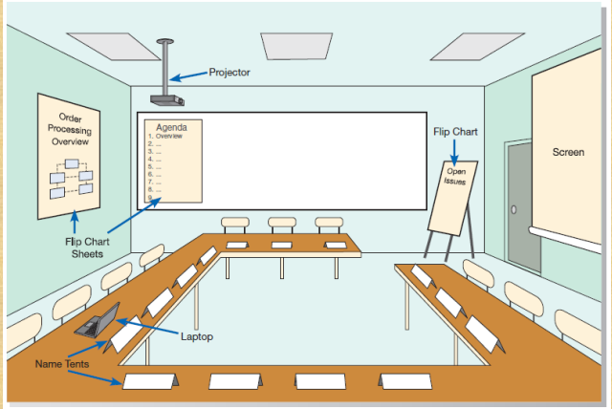
Fig: Typical room layout for a JAD session

Slide 23
The typical participants in a JAD are listed below:
JAD session leader:
organizes and runs the JAD.
sets an agenda and sees that it is met;
May remains neutral on issues and does not contribute ideas or opinions,
but rather concentrates on keeping the group on the agenda, resolving conflicts and disagreements, and manage all ideas.
2. Users:
vital participants in a JAD.
They are the only ones who have a clear understanding of what it means to use the system on a daily basis.

Slide 24
3. Managers:
provide insight into
new organizational directions,
motivations
organizational impacts of systems,
support for requirements determined during the JAD
4. Sponsor:
sponsored by someone at a relatively high level in the company.
If the sponsor attends any sessions, it is usually only at the very beginning or the end.
5. Systems analysts:
Members of the systems analysis team attend the JAD, although their actual participation may be limited.
Analysts are there to learn from users and managers, not to run or dominate the process.

Slide 25
6. Scribe:
takes notes during the JAD sessions.
This is usually done on a laptop.
Notes may be taken using a word processor, or notes and diagrams may be entered directly into a CASE tool.
7. IS staff:
Besides systems analysts, other information systems (IS) staff, such as programmers, database analysts, IS planners, and data center personnel, may attend to learn from the discussion
and possibly contribute their ideas on the technical feasibility of proposed ideas or the technical limitations of current systems.

Slide 26
Prototyping
Is an iterative process of systems development in which
requirements are converted to a working system
that is continually revised through close collaboration between an analyst and users.
will enable you to quickly convert basic requirements into a working, though limited, version of the desired information system.
The prototype will then be viewed and tested by the user.

Slide 27
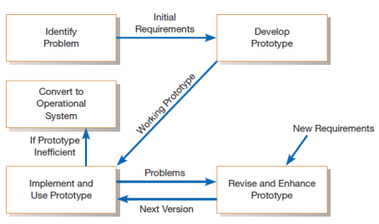
Fig: Prototyping methodology

Slide 28
Prototyping is most useful for requirements determination when:
User requirements are not clear or well understood,
which is often the case for totally new systems or systems that support decision making.
One or a few users and other stakeholders are involved with the system.
Possible designs are complex and require concrete form to evaluate fully.
When Communication problems exist between users and analysts,
and both parties want to be sure that system requirements are as specific as possible.
Tools (such as form and report generators) and data are readily available to rapidly build working systems.

Slide 29
Prototyping also has some drawbacks:
A tendency to avoid creating formal documentation of system requirements,
which can then make the system more difficult to develop into a fully working system.
can become strange to the initial user and difficult to diffuse or adapt to other potential users.
are often built as stand-alone systems, thus ignoring issues of sharing data and interactions with other existing systems.

Slide 30
Radical Methods For Determining System Requirements
Radical - Revolutionary method where changes occur rapidly
The overall process by which current methods are replaced with radically new methods is generally referred to as Business Process Reengineering (BPR).
The idea behind BPR is
to improve each business process
Also reorganize the complete flow of data in major sections of an organization to eliminate unnecessary steps, combine previously separate steps, and become more responsive to future changes.

Slide 31
BPR concepts are applied in both corporate strategic planning and information systems planning as a way to improve business processes radically.
suggest that radical increases in the quality of business processes can be achieved through creatively applying information technologies(tools).
also suggest that radical improvement cannot be achieved by making minor changes in existing processes but rather by using a clean sheet of paper and asking,
"If we were a new organization, how would we accomplish this activity?"

Slide 32
Identifying Processes To Reengineer
The first step in any BPR effort is to understand
what processes to change.
what are the key business processes for the organization
Key business processes are the structured set of measurable activities designed to produce a specific output for a particular customer or market.
key business processes would include all activities used to design, build, deliver, support, and service a particular product for a particular customer
After identifying key business processes, the next step is to identify specific activities that can be radically improved through reengineering.

Slide 33
Need to ask three questions to identify activities for radical change:
1. How important is the activity to delivering an outcome?
2. How feasible is changing the activity?
3. How dysfunctional is the activity?
The answers to these questions provide guidance for selecting which activities to change.
Those activities deemed important, changeable, yet functional, are primary candidates for alteration.

Slide 34
Disruptive Technologies:
Analyst must learn about the power of new technologies and think of innovative ways to alter the way work is done.
This approach is opposite to deductive thinking, in which problems are first identified and solutions then formulated.
Disruptive Technologies are those that enable breaking long-held business rules that discourage organizations to make making radical business changes.

